Slide 1

Simple Analytics with MongoDB

Slide 2

About Me
I’m Ross Affandy. Senior Developer Cum System Administrator at Carlist.MY
MongoPress Core Developer

Slide 3
I will talking about:
- Our stack (architecture)
- Our problem
- Our solution
- Our lesson

Slide 4
Stack in cloud
Platform – Linux (Amazon Distro)
Database – MongoDB
Language – PHP (API)
Webserver – NginX
(Sorry node.js – I’m not developing event-driven programming or require long pulling persistent connection)
Using Amazon EC2 micro instance
600MB RAM
8GB EBS root partition
30GB EBS partition for MongoDB storage (format as xfs filesystem)
Why Amazon Cloud?
I want to save 70% of my time managing infrastructure and focus to writing code

Slide 5
Business Analytics Essential
- Bank use business analytics to predict & prevent credit card fraud
- Retailers use business analytics to predict the best location for store and reach target market
- Even sports team use business analytics to determine game strategy and ticket price

Slide 6
Problem to solve
Real time data collection :
- Implementing pageview counter
- Simple Analytics
Why MongoDB?
- MySQL usually blocked on file system reads
Good at saving large volume of data
Support asynchronous insert ( fire & forget )
- Fast access to large binary object
Read/write ratio is highly skewed to reads
Upsert ( simplify my code )

Slide 7
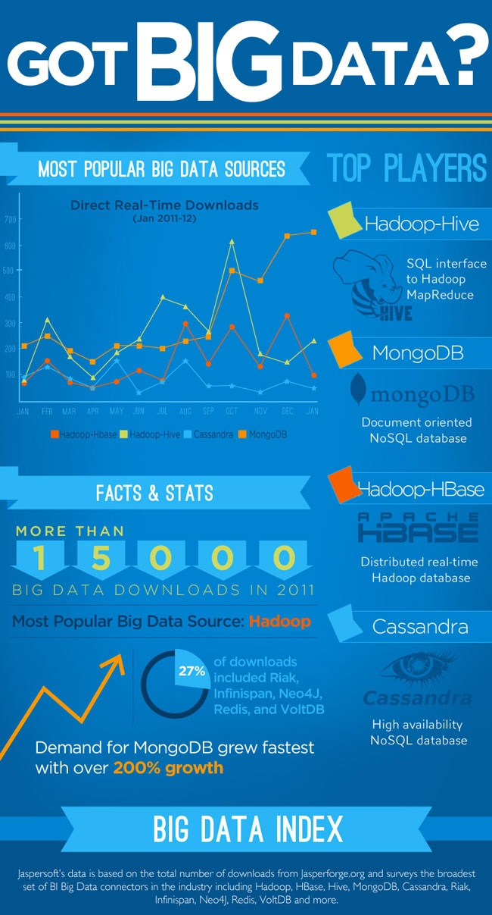

Slide 8
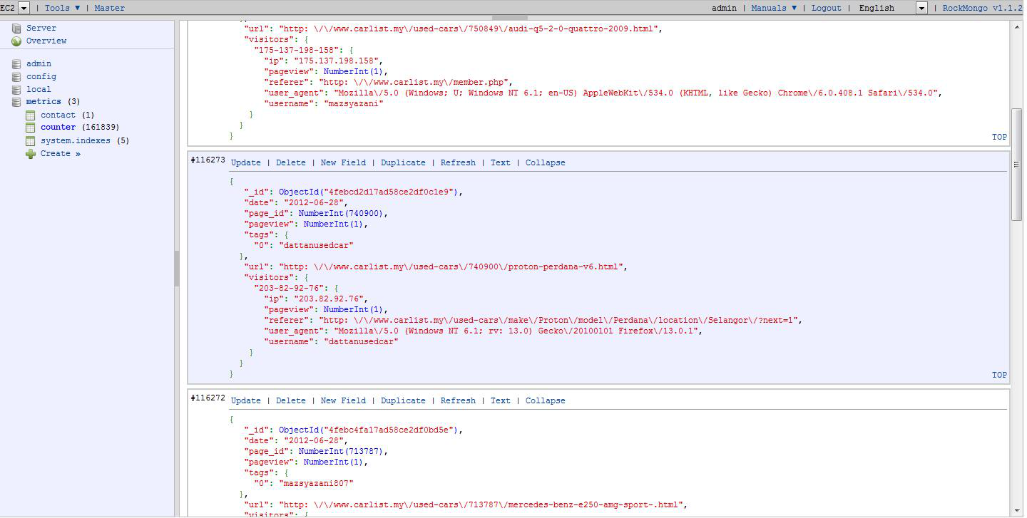
Data structure and how it look like?

Slide 9
Now the story begin!

Slide 10
Problem / Challenge
We face many exciting challenges ( expect the unexpected )
Implementation
We use map reduce to gather the information that we collect
What is map reduce in MongoDB and why we use it?
- Equal to count/sum/avg/group by function with MySQL.
- Map reduce is easier to understand
- Useful to process large dataset concurrently in large cluster of machines (sorry for this, we don’t have budget yet ☹)
Problem
Map reduce very slow and crash the server due to the javascript engine and lack of processing power (low RAM and cpu)
MongoDB also has a group() function. Why not use it?
Group() function only return single bson object (less than 16mb). Not useful for unique data more than 10,000 value

Slide 11
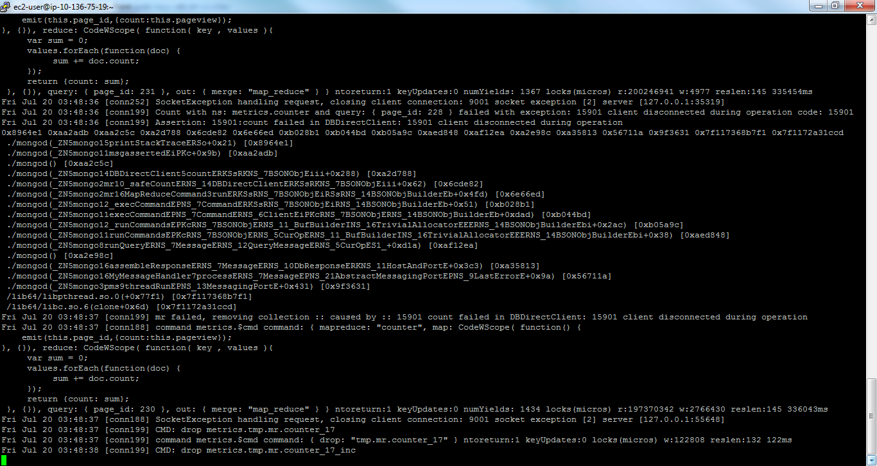
Problem / Challenge

Slide 12
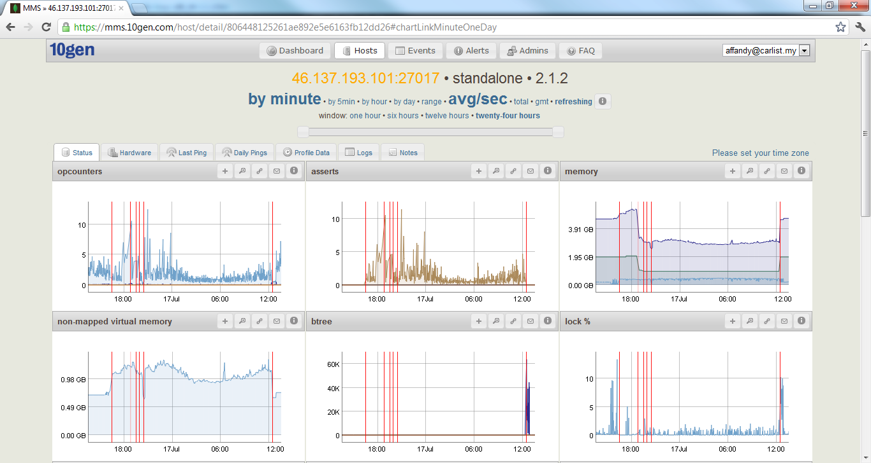
Problem / Challenge

Slide 13
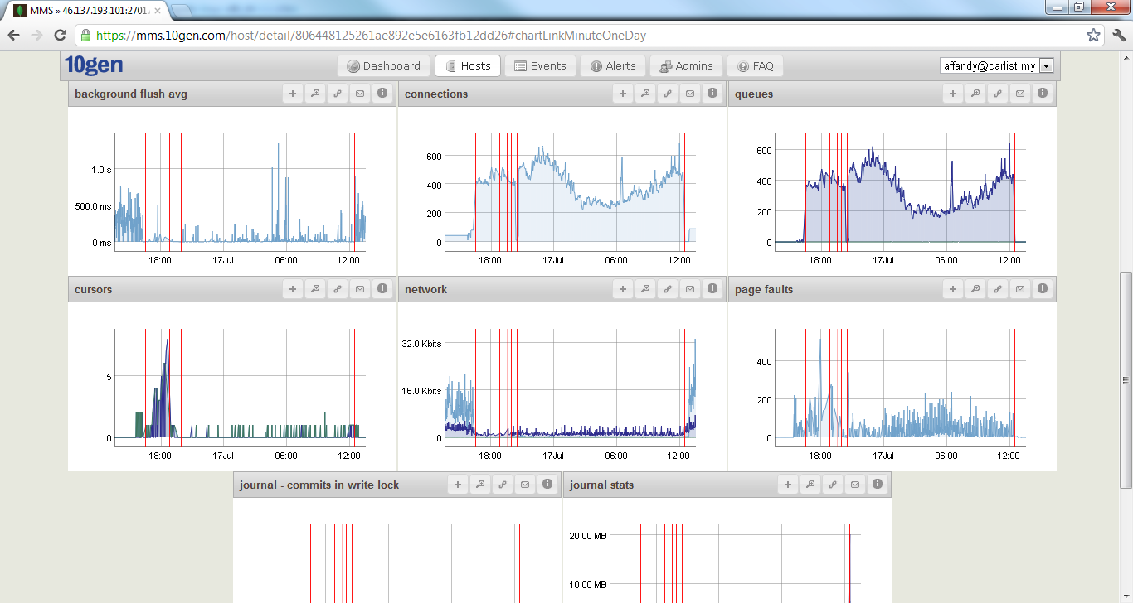
Problem / Challenge

Slide 14
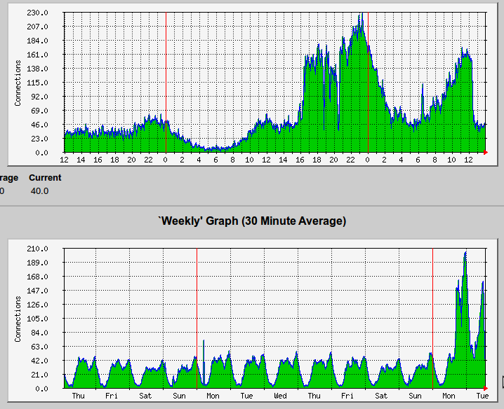
Problem / Challenge

Slide 15


Slide 16
Moving to aggregation framework
Quickly running latest version of MongoDB just to get aggregation function
Changing PHP query to using aggregation instead of map reduce
Good news
Server not crash
Bad news
Aggregation is better but still need more RAM to process 2 million document. Still slow.

Slide 17


Slide 18
Experiment
Test run on Amazon SSD + 64GB RAM (Virginia)
- Copy 12GB data to another amazon EC2 instance
Run the map reduce and aggregation query to see what break.
Nothing break. Server look happy ☹
Problem Solve?
Yes, but server cost is too expensive.

Slide 19
Solution
Denormalization
In computing, denormalization is the process of attempting to optimise the read performance of a database by adding redundant data or by grouping data.In some cases, denormalisation helps cover up the inefficiencies inherent in relational database software. A relational normalised database imposes a heavy access load over physical storage of data even if it is well tuned for high performance.
Copying of the same data into multiple documents or tables in order to simplify/optimize query processing
Be careful about duplicate data that will easier make database big
When to denormalize?
Query data volume or IO per query VS total data volume.
Processing complexity VS total data volume.
Now everytime user access the page, we run 2 query.
Capture the data for analytics
Update other collection to replace group by. Later on will be use to display to user.

Slide 20
Summary / Lesson learned
- We learned what makes MongoDB a good analytics tool
- Data modeling is important.
What questions do I have?
What answers do I have?
- Design query before design schema
Simplified everything
MapReduce is slower and is not supposed to be used in “real time.”
TIPS
Always run load / stress test before go live
1) capacity planning
2) capacity testing
3) performance tuning
Tools
1) Dex performance tuning tool from mongolab is really helpful - https://github.com/mongolab/dex

Slide 21
It's not about winning,
        It's all about taking part!

Slide 22
Contact
Website: http://www.carlist.my
Email: enquiries@carlist.my
We also hiring!
jobs@carlist.my

Slide 23
Q&A?

